Slide 1
Gieni Lookup Bot
Orderfox Challenge Datathon 2025
Hanno Hiss, Philippe Zwick, Laurenz Zehetner, Maximilian Scheidl

Slide 2
Data Preprocessing
13.000+ Websites each containing 58 subpages on average
Identified Problems
CSS files
Duplicated pages
Images and Video embedded as text
Redundant text (Imprint is on every page)
Solution
Removing CSS files reduced around 10% of redundant text
Cutting all pages which have more than 50.000 Characters to avoid images in

Slide 3
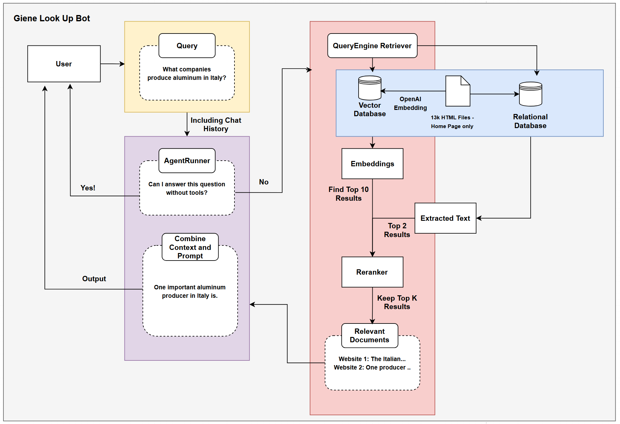
Notes:
Vector Search using Open AI Embeddings
Addition Keyword search to utilize all the data
Reranking of retrieved documents
Interactive Querying with an Agent

Slide 4
Workflow

Slide 5
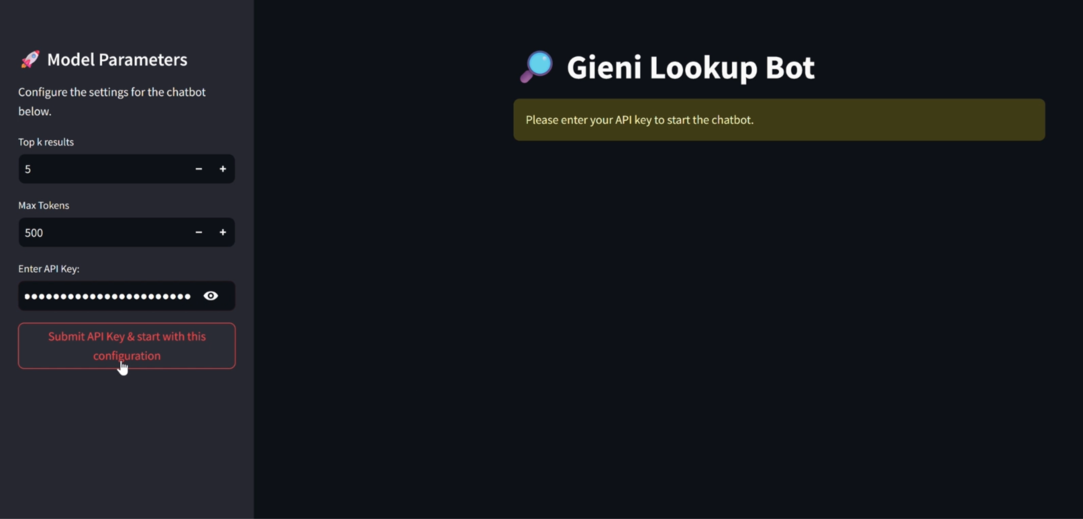
Add API Key

Slide 6
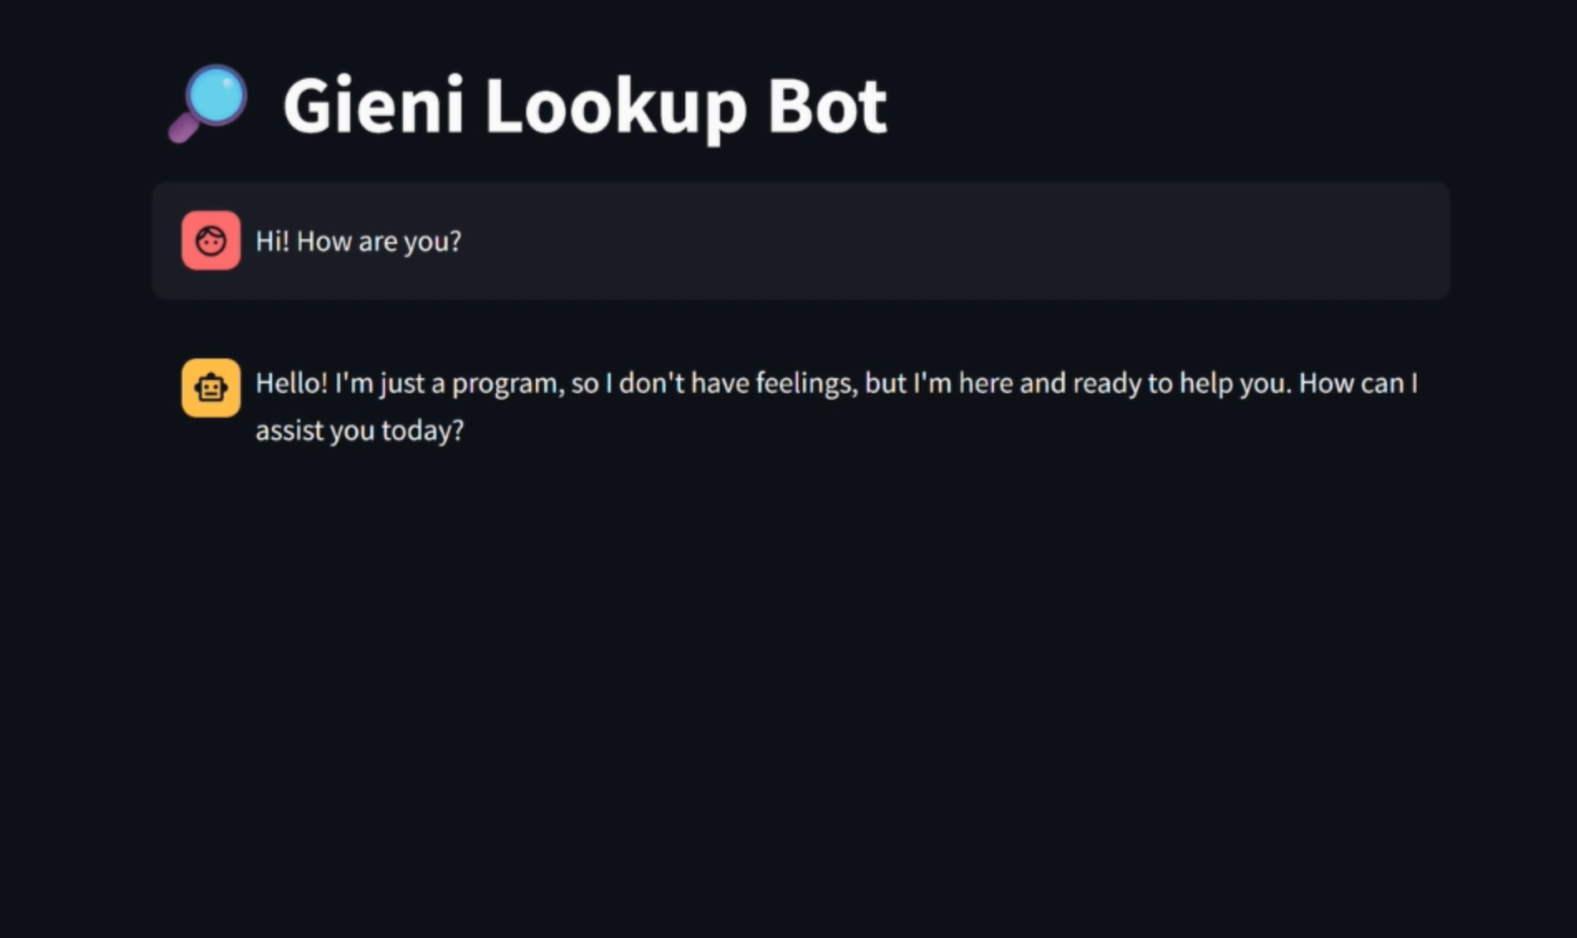
2. Greet Politely

Slide 7
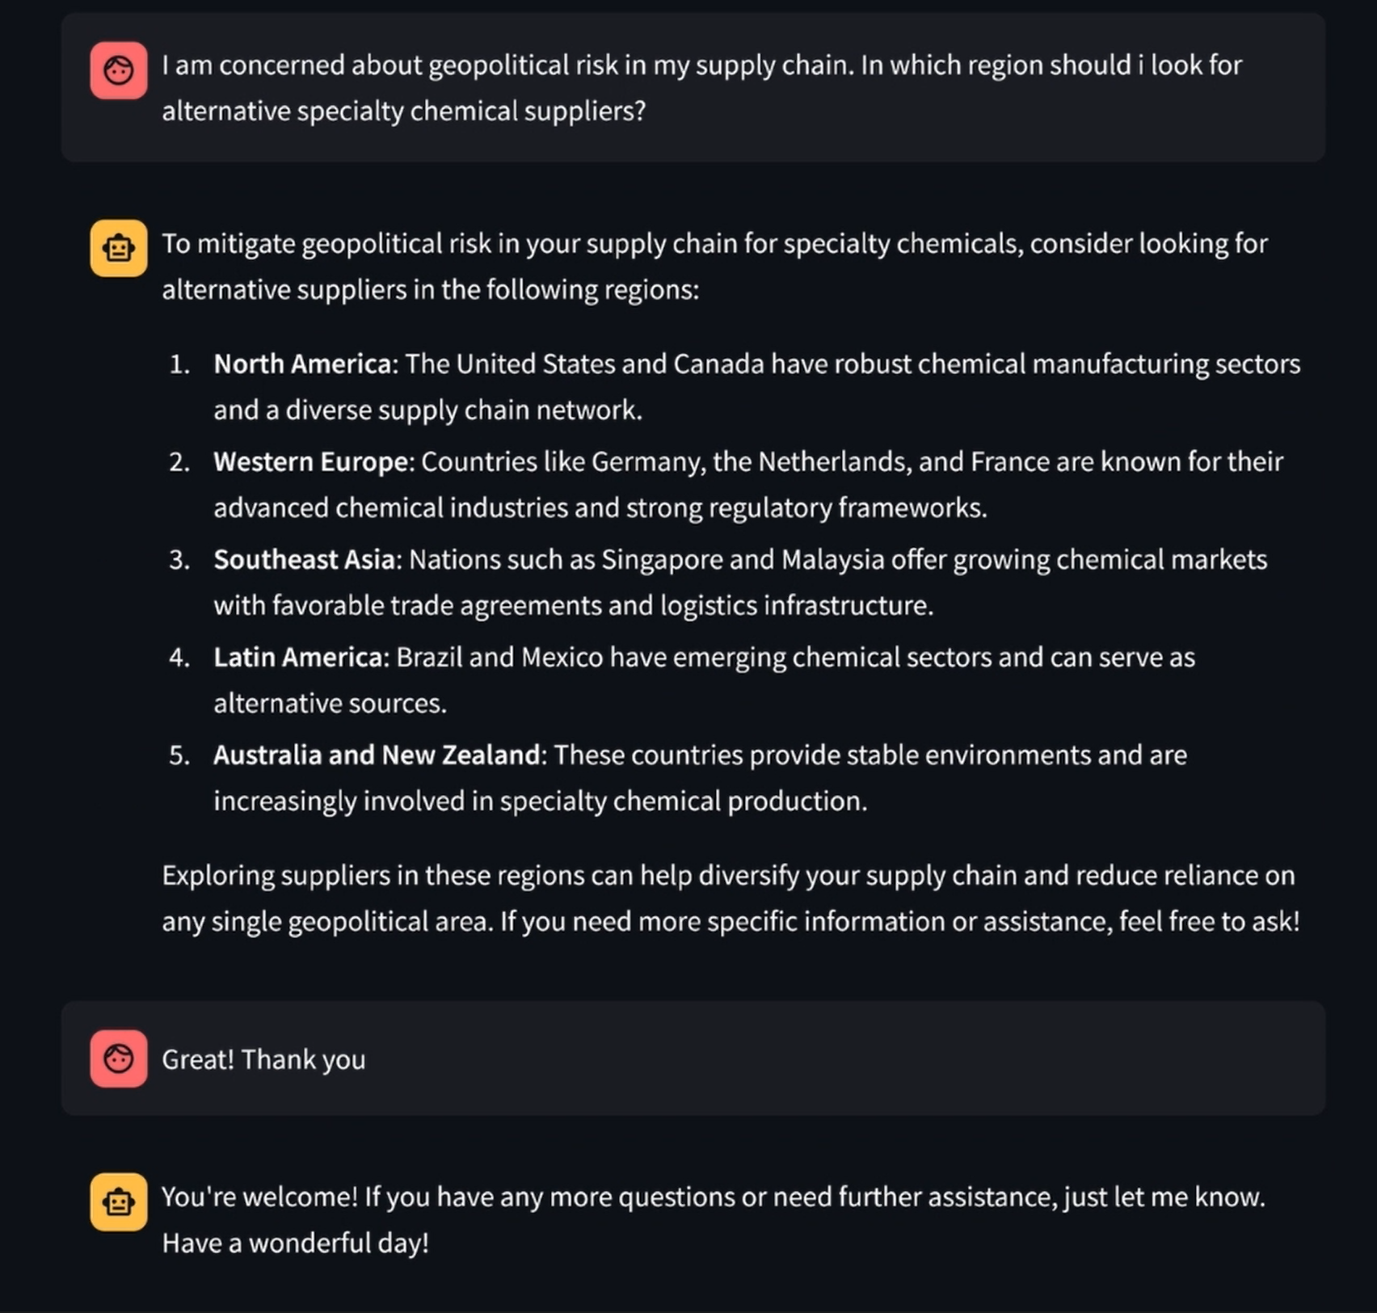
3. Ask your Questions

Slide 8
4. Don’t forget to say Thank You (once)

Slide 9
Future Ideas
Active Fine-Tuning
To better address the relevance problem, one can use test time fine tuning to optimize information gain about the query rather then naive similarity search.
Utilize the whole data
Either embed all with Open AI and wait for some days or use smaller models for faster ingestion at the cost of retrieval accuracy
Metadata Extraction
Using LLMs to scrape structured metadata from all pages to further improve retrieval
More Data Cleaning
Removing redundant text or summarize pages to their main contents to reduce noise

